Slide 1
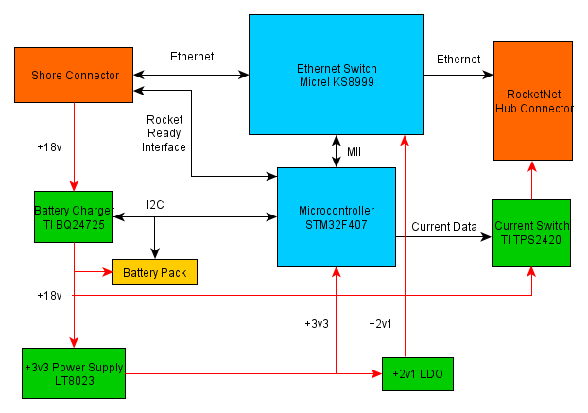
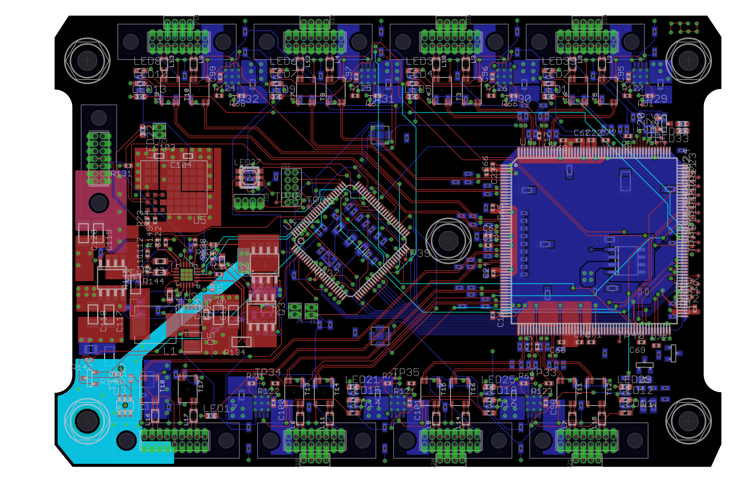

PSAS RocketNet Hub || Capstone 2012-2013
Sponsor---Andrew Greenberg | Members--Jackson Pugh---Michael Woodruff---JJ Hartley | Faculty Advisor---Dr. Richard Campbell
Overview
The capstone sponsor, Portland State Aerospace Society (PSAS) designs, builds, and launches high power rockets. Their 2013 Capstone project is a power management and communications solution for use in both their current and next generation launch vehicles. To accommodate the size and weight restrictions imposed by the physical characteristic of the current launch vehicle, the decision was made to pursue a highly integrated solution which would provide for all the power management functions as well as provide low latency communication between all of the electronic subsystems used in-flight.
Subsystems Design
Communications:
Initially specified as USB, the communications subsystem was then changed to operate using the CAN Bus due to latency. This was then re-specified again to use 100Mbps Ethernet. An 10/100 Mbps 8+1 port switch-on-chip from Micrel was selected as it was the only device with the required functionality available to small scale designers.
Microcontroller:
PSAS has made the switch to STM32 microcontrollers for their nodes and requested that the same MCU be used to control this board. It is a compact ARM Cortex based microcontroller that is well suited to scalable embedded designs. The MCU’s primary functions are to control the battery charger, Ethernet switch, and each node’s power switch. Secondary functions are monitoring the battery’s charge state, current consumption of each node, and to reset the Ethernet switch in case it faults.
Power Domains:
The complexity of the this project was greatly increased by the requirement to accommodate five separate power domains on the same board. There are two primary supplies, an 18VDC external supply and a 4-cell LiPo battery stack. These feed the high voltage rail that powers the seven nodes and the 3.3V switching regulator. The 3.3V power domain supplies the onboard logic and a 2.1V LDO . The 2.1V power domain is used by the Ethernet switch.
Power Distribution:
Each of the seven nodes can be switched on or off by use of a hot swop controller with integrated power FET. This solution allows for current ramping when a node is turned on, power fault handling, and current monitoring.
Requirements
The board should contain the following:
Support at least seven independent nodes
High reliability and fail-safe design
Provide low latency inter-node communications using a common protocol
Independent power management for each node in-flight and battery management pre-flight
High efficiency switching power regulation from high voltage battery pack and low voltage logic
Low-power consumption when in standby mode
High-Level Block Diagram
RocketNet Power and Data Distribution Board Layout
Department of Electrical and Computer Engineering
†Background image is a screenshot of the STM32 microcontroller schematic in Eaglecad

